Slide 1
Pizza SALES analysis with sql &EXCEL
NAME: MUHAMMAD UMAIR
TOOLS USED DATASET
MY SQL ROWS 40800
EXCEL COLUMNS: 12
POWERPONT

Slide 2
.
PROBLEM STATEMENT
THERE IS A LARGE DATASET OF PIZZA SALES NOW IT’S YOUR TASK TO MONITOR AND EVALUATE TRACK PERFORMENCE OVER TIME OF THIS LARGE DATASET BY USING KPIs TO GET INSIGHTS AND MAKE DATA-DRIVEN DECISION TO QUANTIFY PERFORMANCE ,IDENTIFY TRENDS AND HIGHLIGHTS WEAK AREAS WHERE FOCUS IS NEEDED.
,
OBJECT
EVALUATE PERFORMANCE
IDENTIFY TRENDS
HIGHLIGHTS WEAK AREA

Slide 3
.
PROBLEM STATEMENT
THERE IS A LARGE DATASET OF PIZZA SALES NOW IT’S YOUR TASK TO MONITOR AND EVALUATE TRACK PERFORMENCE OVER TIME OF THIS LARGE DATASET BY USING KPIs TO GET INSIGHTS AND MAKE DATA-DRIVEN DECISION TO QUANTIFY PERFORMANCE ,IDENTIFY TRENDS AND HIGHLIGHTS WEAK AREAS WHERE FOCUS IS NEEDED.
,
OBJECT
EVALUATE PERFORMANCE
IDENTIFY TRENDS
HIGHLIGHTS WEAK AREA

Slide 4
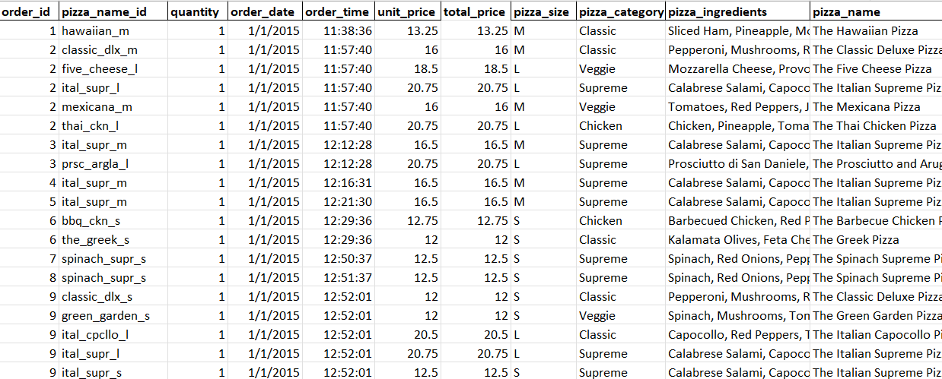
.
NATURE OF DATASET
.
,
DATASET OF PIZZA SALES
ROWS : 48621
COLUMNS : 11

Slide 5
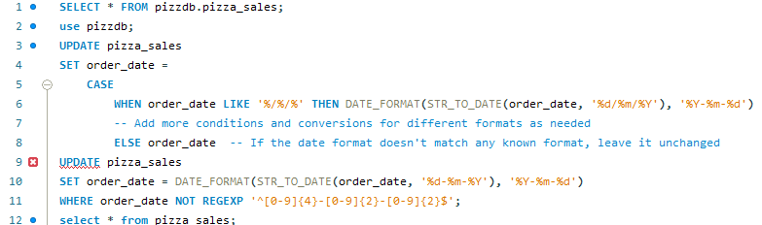
STEPS FOLLOWED IN DATA ANALYSIS IN SQL
STEP1 DATA PREPROCESSING
First I looed at dataset file in which format it was present because SQL only support csv or Jason but xlsx so dataset file was already in csv file.
After that I check datatype of each column where I found date column where date was present in string type and different formats which was not in a desired format that SQL supports

Slide 6
STEPS FOLLOWED IN DATA ANALYSIS IN SQL
STEP2 DATA PREPROCESSING

Slide 7
.
KEY PEROFRMANCE METRICS (KPIs)
TOTAL REVENUE :The sum of all the revenue generated from sales.
TOTAL ORDERS : The quantity of orders processed within a given timeframe.
Average order quantity : Average no of pizzas order per order
TOTAL PIZZA(QUANTIY) SOLD : Total pizza sold within a given timeframe
,
OBJECT
EVALUATE PERFORMANCE
IDENTIFY TRENDS
HIGHLIGHTS WEAK AREA

Slide 8
.
KEY PEROFRMANCE METRICS (KPIs)
AVERAGE PIZZA (QUNTIY )SOLD : Average no of pizza sold per order/month/week/day
AVERAGE ORDER PRICE : AVERERAGE UNIT PRICE
TOTAL REVENUE BY CATEGORY : Total revenue generated by each catergory/name of pizza.
,
OBJECT
EVALUATE PERFORMANCE
IDENTIFY TRENDS
HIGHLIGHTS WEAK AREA

Slide 9
.
KEY PEROFRMANCE METRICS (KPIs)
IDENTIFY TRENDS
AVERAGE PIZZA (QUNTIY )SOLD : Average no of pizza sold per/month/week/day.
TOTAL REVENUE BY MONTH/WEEK/DAY : Total revenue generated by each month, week and day, of pizza.
PEAK TIME OF PIZZA ORDERS : AT what time to receive good amount of orders.
,
OBJECT
EVALUATE PERFORMANCE
IDENTIFY TRENDS
HIGHLIGHTS WEAK AREA

Slide 10

.
KEY PEROFRMANCE METRICS (KPIs)
Total Revenue: The sum of all the revenue generated from sales
Query;
Select sum(total_price) as Total_revenue, from pizza_sales;
This the total revenue generated in 12 months by pizza sales in 2015
,
OBJECT
EVALUATE PERFORMANCE
IDENTIFY TRENDS
HIGHLIGHTS WEAK AREA

Slide 11


.
KEY PEROFRMANCE METRICS (KPIs)
2 Total Orders: The count or quantity of orders received or processed within a given timeframe.
Query;
SELECT COUNT(distinct order_id) AS Total_orders from pizza_sales;
Total orders reveived by pizza outlet in 2015
,

Slide 12

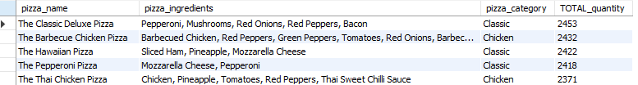
.
KEY PERFORMANCE METRICS (KPIs)
3 Total pizzas sold (total units) sold by pizza category/name
Query;
select pizza_category, sum(quantity) as Total_Quantity_Sold from pizza_sales group by pizza_category ;
,

Slide 13
KEY PERFORMANCE METRICS (KPIs)
3 Total pizzas sold (total units) sold by pizza category/name
Statement
The classic category has the highest no of quantity sold
To get a clear picture we added the pizza name and ingredient column to get a complete idea of which type of pizza has the highest quantity sold and what ingredients were used in those pizzas.
,

Slide 14
KEY PERFORMANCE METRICS (KPIs)
3 Total pizzas sold (total units) sold by pizza category/name
RECOMMENATION
In total revenue high by /name belongs chiken cat pizzas
T
highest quantity sold by name belongs classic cat
Satisfaction of customer can be seen in ordering pizza beolgs classic
But in revenue contributed by chicken category name, we can slightly increased price on classic cat due to cust prefernces and giving dis bases on past orders
,

Slide 15
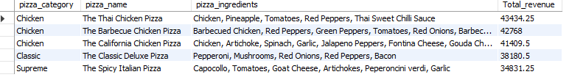
KEY PERFORMANCE METRICS (KPIs)
3 Total revenue by name; generated by pizza name
Query;
select pizza_category, sum(total_price) as Total_revenue from pizza_sales group by pizza_category,pizza_name ;
Comment.
The highest revenue generated by the pizza name is the Thai, chicken pizza from the chicken category whereas the highest quantity sold of the classic deluxe pizza from classic category
,

Slide 16

KEY PERFORMANCE METRICS (KPIs)
pizza from classic category
,

Slide 17
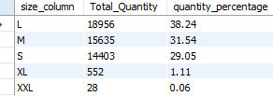
,
KEY PERFORMANCE METRICS (KPIs)
Total Quantity sold by pizza size;
By adding this insight into the previous findings now we can get a picture related to inventory management where we see the top pizza name from the classic and chicken categories and ingredients used in those top highest-sold pizzas here we can see below what size customer preference, we can arrange stock according to this findings, we can give temporary discount on low preference size and slightly increase large size also without any doubt we can add large size in the menu
,

Slide 18
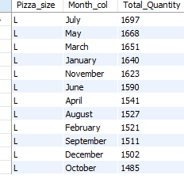
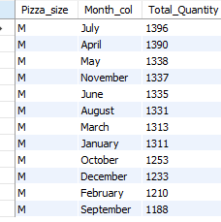
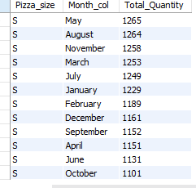
,
KEY PERFORMANCE METRICS (KPIs)
IDENTIFY TRENDS
Total Quantity sold of pizza by size during specific timeframe;
The monthly trend of sales volume(quantity)
we can see volume sales of large pizza is 38%.24.
31.54% of M
,

Slide 19
,
KEY PERFORMANCE METRICS (KPIs)
IDENTIFY TRENDS
Total Quantity sold of pizza by size during specific timeframe;
Descion we can make
Invetory management; we can adust stock during peak and in slower months avoid overstocking after seeing volume sales of xl,xxl, we see consistent in l,m,s vol sales no seasonal fluctuation except October in all three categories, so we can slighty increase pricing and give temporary discount in small, and large in october
,

Slide 20
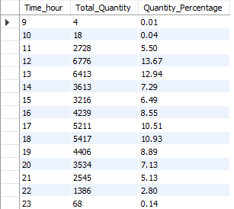
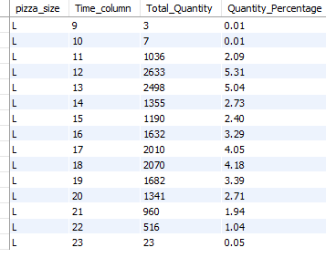
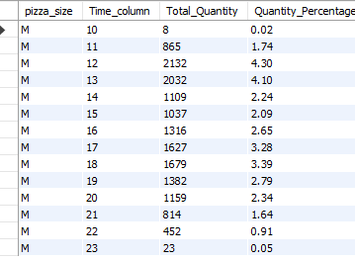
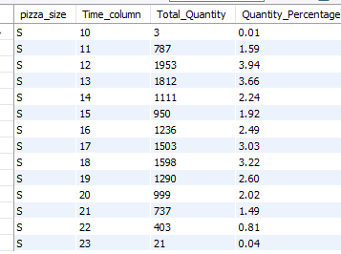
,
KEY PERFORMANCE METRICS (KPIs)
IDENTIFY TRENDS
Total Quantity sold of pizza by size during specific timeframe;
Hour trend of volume sales BY peak hours
,

